Slide 1
Smart Irrigation System
HackDay 09/12

Slide 2
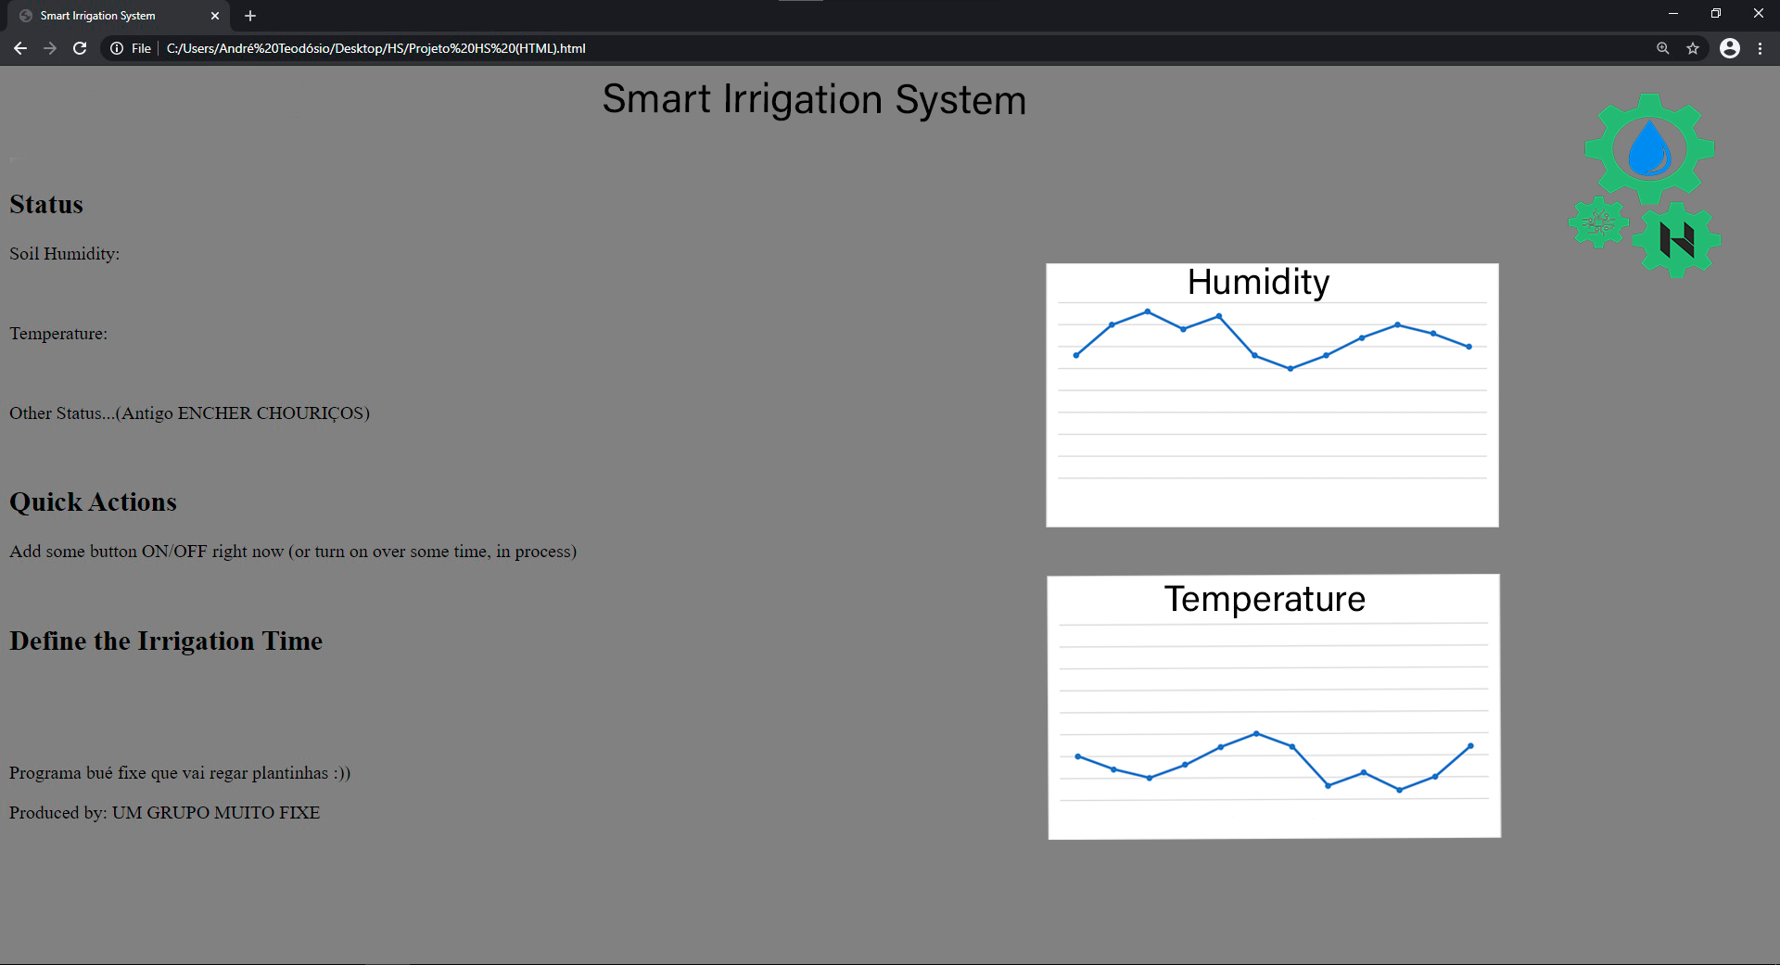
HTML Final.1

Slide 3
Back-end: Updates

Slide 4
Merry Christmas
:)

